Slide 1
Flight Price Prediction Project

Slide 2
INTRODUCTION
Business Problem Framing
Anyone who has booked a flight ticket knows how unexpectedly the prices vary. The cheapest available ticket on a given flight gets more and less expensive over time. This usually happens as an attempt to maximize revenue based on –
Time of purchase patterns (making sure last-minute purchases are expensive)
Keeping the flight as full as they want it (raising prices on a flight which is filling up in order to reduce sales and hold back inventory for those expensive last-minute expensive purchases)
Therefore, a predictive model to accurately predict Air fares is required to be made.

Slide 3
Hardware and Software Requirements and Tools Used
Hardware Used:
Processor: AMD Ryzen 9 5900HX(8 Cores 16 Logical Processors)
Physical Memory: 16.0GB (3200MHz)
GPU: Nvidia RTX 3060 (192 bits), 6GB DDR6 VRAM, 3840 CUDA cores.

Slide 4
Hardware and Software Requirements and Tools Used
Software Used:
Windows 10 Operating System
Anaconda Package and Environment Manager: Anaconda is a distribution of the Python and R programming languages for scientific computing, that aims to simplify package management and deployment. The distribution includes data-science packages suitable for Windows and provides a host of tools and environment for conducting Data Analytical and Scientific works. Anaconda provides all the necessary Python packages and libraries for Machine learning projects

Slide 5
Hardware and Software Requirements and Tools Used
Jupyter Notebook: The Jupyter Notebook is an open-source web application that allows data scientists to create and share documents that integrate live code, equations, computational output, visualizations, and other multimedia resources, along with explanatory text in a single document.
Python3: It is open source, interpreted, high level language and provides great approach for object-oriented programming. It is one of the best languages used for Data Analytics And Data science projects/application. Python provides numerous libraries to deal with mathematics, statistics and scientific function.

Slide 6
Hardware and Software Requirements and Tools Used
Python Libraries used:
Pandas: For carrying out Data Analysis, Data Manipulation, Data Cleaning etc
Numpy: For performing a variety of operations on the datasets.
matplotlib.pyplot, Seaborn: For visualizing Data and various relationships between Feature and Label Columns
Scipy: For performing operations on the datasets
Statsmodels: For performing statistical analysis
sklearn for Modelling Machine learning algorithms, Data Encoding, Evaluation metrics, Data Transformation,Data Scaling, Component analysis,Feature selection etc.

Slide 7
Exploratory Data Analysis
Visualizations
Barplots,Distplots,Boxplots,Countplots,lineplots were used to visualise the data of all the columns and their relationships with Target variable.

Slide 8
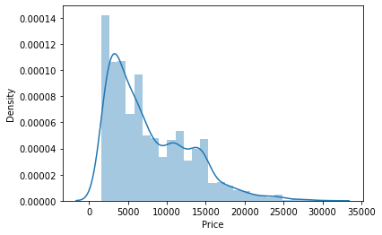
Exploratory Data Analysis
Univariate Analysis
Analyzing the Target Variable

Slide 9
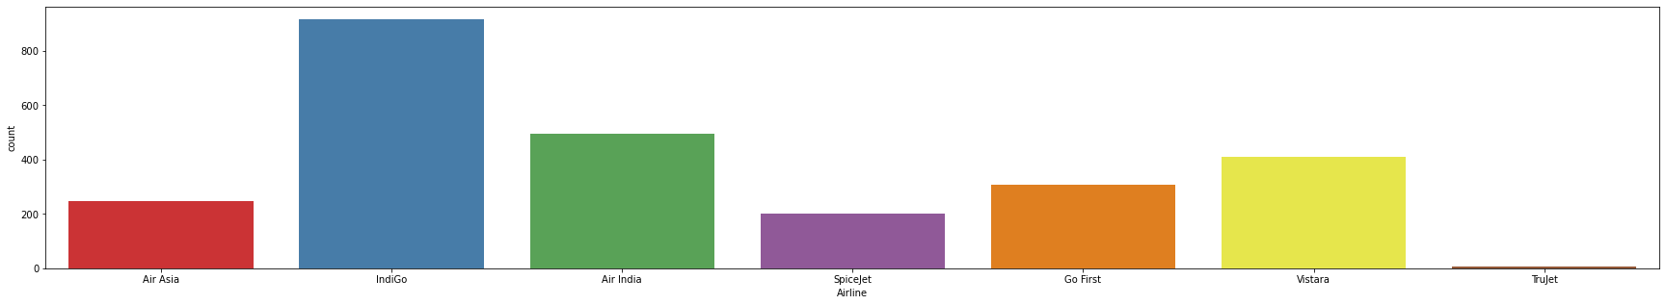
Exploratory Data Analysis
Analyzing the Feature Columns

Slide 10
Exploratory Data Analysis
Following observations are made from graphs above:
IndiGo has the highest number of flights followed by Air India and Vistara
Highest number of flights are from Delhi followed by Mumbai, Kolkata,Bangalore and Hyderabad
New Delhi is the most popular destination followed by Bangalore, Goa, Kolkata and Mumbai
Highest number of flights have only 1 stop between source and destination while 2nd highest number of flights are non stop

Slide 11
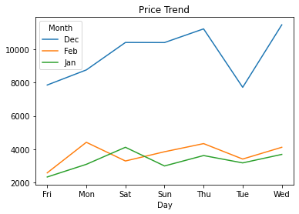
Exploratory Data Analysis
Bivariate Analysis
Interpreting Relationship between Dependent Variable and Independent Variable Columns
Analyzing Relationship between Day, Month columns and Price

Slide 12
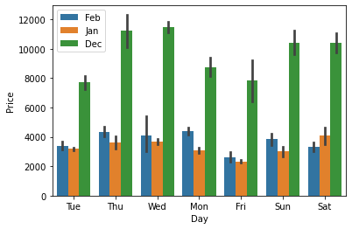
Exploratory Data Analysis

Slide 13
Exploratory Data Analysis
Following observations are made from graphs above:
On an average, there is a steady decline in Flight price from December to February, with the prices being lowest in January.
Flight Prices increase on an average, as the day of departure gets nearer.
Flight Ticket prices are the highest on Thursdays,Mondays and during the weekend on an average.

Slide 14
Exploratory Data Analysis
Following Observation were made after analysing the problem statement:
Trujet, IndiGo,SpiceJet and Air Asia offer air tickets at the most affordable prices on average, whereas Vistara, Air India are the most expensive on average.
It can be observed that Number of Stops impact the travel time of Airlines.
It can be observed that Number of Stops impact the Air Ticket Pricing of Airlines.
There is a linear relationship between Price and flight duration.

Slide 15
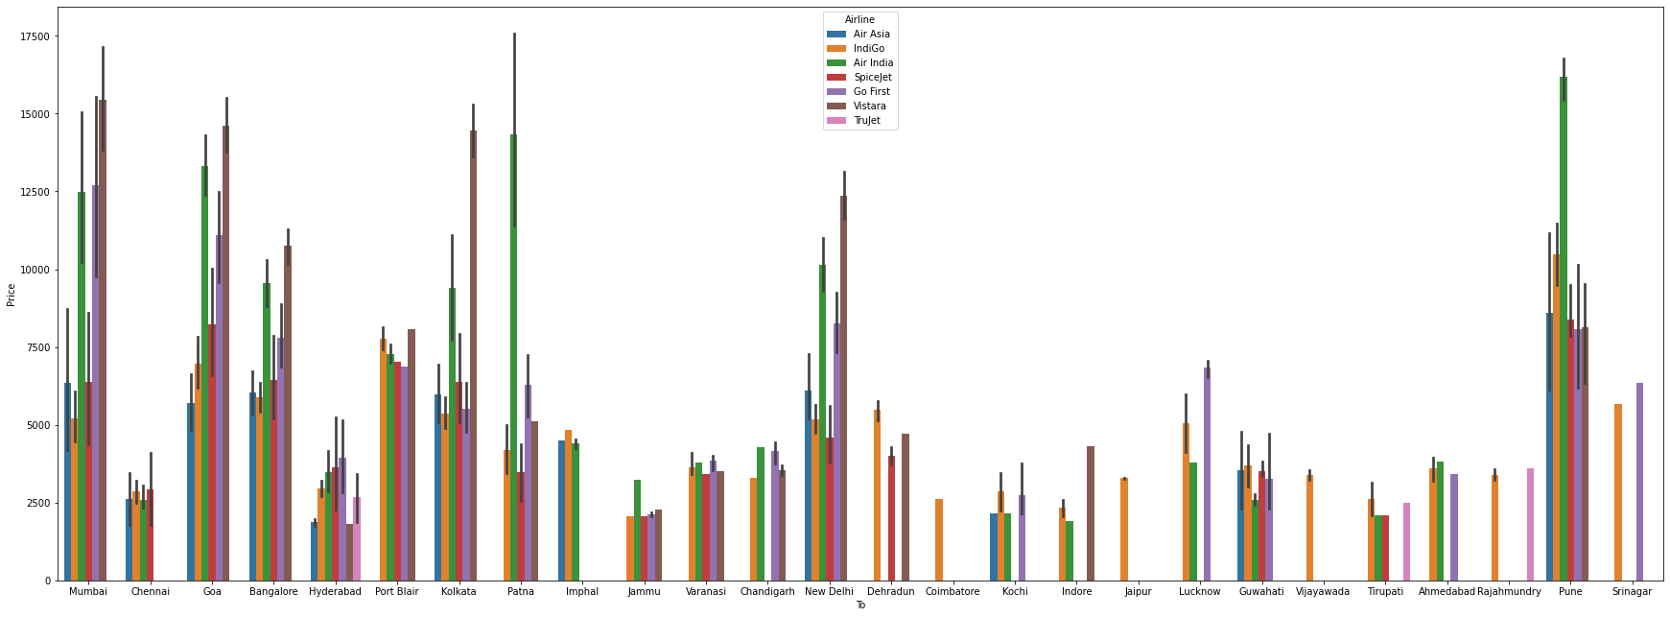
Exploratory Data Analysis
Multivariate Analysis

Slide 16
Exploratory Data Analysis
Following Observations are made from graphs above:
There is a linear relationship between Price and flight duration.
Indigo,Air Asia and Spicejet provide most affordable Airtickets to the destinations.

Slide 17
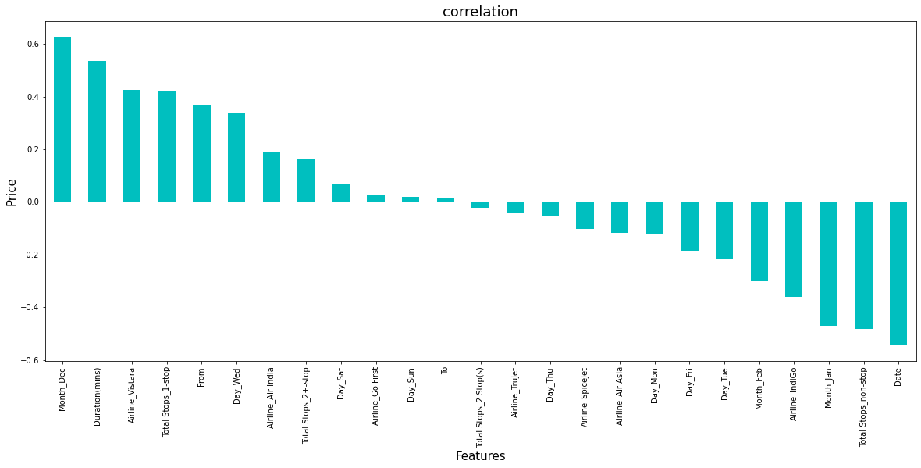
Exploratory Data Analysis

Slide 18
Exploratory Data Analysis
It is observed that Month_Dec, Duration(mins), Airline_Vistara,Total Stops_1-stop and From have the highest positive correlation with Price, while Date,Total Stops_non-stop,Month_Jan,Airline_IndiGo have the highest negative correlation with Price.

Slide 19
Model/s Development and Evaluation
Feature Selection
Features were first checked for presence of multicollinearity and then based on respective ANOVA f-score values, the feature columns were selected that would best predict the Target variable, to train and test machine learning models.
Using SelectKBest and f_classif for measuring the respective ANOVA f-score values of the columns, the best features were selected. Using StandardScaler, the features were scaled by resizing the distribution values so that mean of the observed values in each feature column is 0 and standard deviation is 1.
From sklearn.model_selection’s train_test_split, the data was divided into train and test data. Training data comprised 75% of total data where as test data comprised 25% based on the best random state that would result in best model accuracy.

Slide 20
Model/s Development and Evaluation
The model algorithms used were as follows:
Ridge
DecisionTreeRegressor
XGBRegressor
RandomForestRegressor:
Support Vector Regressor:

Slide 21
CONCLUSION
Key Findings and Conclusions of the Study and Learning Outcomes with respect to Data Science
Based on the in-depth analysis of the Flight Price Prediction Project, The Exploratory analysis of the datasets, and the analysis of the Outputs of the models the following observations are made:
Air Fare attributes like Date,Month,Duration,Total Stops etc play a big role in influencing the used Flight price.
Airline Brand also has a very important role in determining the used Flight Ticket price.

Slide 22
CONCLUSION
Various plots like Barplots,Countplots and Lineplots helped in visualising the Feature-label relationships which corroborated the importance of Air Fare features and attributes for estimating Flight Ticket Prices.
Due to the Training dataset being very small, only very small amount of the outliers was removed to ensure proper training of the models.
Therefore, Random Forest Regressor, which uses averaging to improve the predictive accuracy and controls over-fitting. performed well despite having to work on small dataset and produced good predictions that can be understood easily.

Slide 23
CONCLUSION
Learning Outcomes of the Study in respect of Data Science
Data cleaning was a very important step in removing plenty of anomalous data from the huge dataset that was provided.
Visualising data helped identify outliers and the relationships between target and feature columns as well as analysing the strength of correlation that exists between them.

Slide 24
CONCLUSION
Limitations of this work and Scope for Future Work
A small dataset to work with posed a challenge in building highly accurate models. This project also relied heavily on historical data and was unable to account for various other factors that influence demand and ticket pricing like pandemic status affecting demand, government regulations on air travel, shifting in routes, weather conditions, etc.
Most airline companies also do no publicly make available their ticket pricing strategies, which makes gathering price and air fare related data sets using web scraping the only means to build a dataset for building predicting models.
Availability of more features and a larger dataset would help build better models.

Slide 25
Thank You (:

